Slide 1
Integrating Herbicide Toxicity and Exposure
Lisa Corey
Intertox, Inc.
Seattle, WA

Slide 2
About Us
Intertox is a science business with a proven track record of building strategic solutions and applications that achieve business goals of our clients.
Strategy focused
Science & technology integration to meet sophisticated needs
Multidisciplinary to solve complex problems
Blended Solutions
Science-based staff
Apply leading edge science solutions to business problems
Reduce liabilities or ensure regulatory compliance
Strength in
Execution
Private, Public, Not for Profit
Forbes 500 list
National and International clients
Trusted
Advisor
Committed to quality
Ensuring health protection
Results orientated
Accountable
Partner
Privately owned
Founded in 1995
Stable Organization

Slide 3
General Capabilities
Broad range of chemical agents including: consumer products, building materials, petroleum products, combustion by-products, common pollutants, EDCs, pharmaceuticals, and exotics
Chemical agents
Biological agents
Bacterial and fungal agents in environmental media and food
Risk evaluations
Single to multi-pathway risk assessments
Air (including indoor air), water, soil, consumer products, drugs, medical devices, and waste
Media
Regulatory compliance
State (including NY, MA, CT, ME, NJ), Federal (EPA, FDA, CPSC, USDA) International (Europe, RSA, Bahamas, Asia)
Risk communication
Providing science based accurate information used in communicating with stakeholders

Slide 4
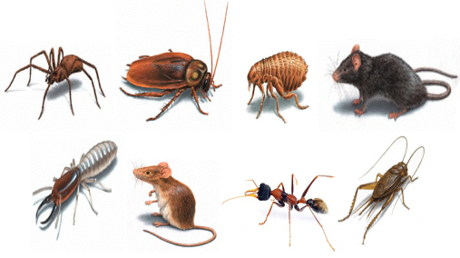
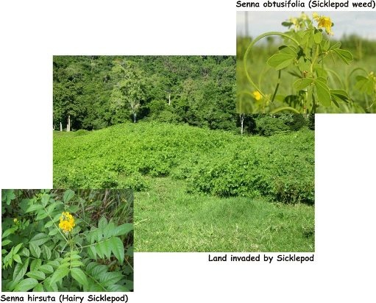
Pesticides
A pesticide is a chemical used to prevent, destroy, or repel pests.
http://www.pestprocanada.com/pest_control_toronto.html
Pests can be insects, mice and other animals, weeds, fungi, or microorganisms such as bacteria and viruses.
http://www.whitsunday.qld.gov.au/web/guest/weed-management

Slide 5
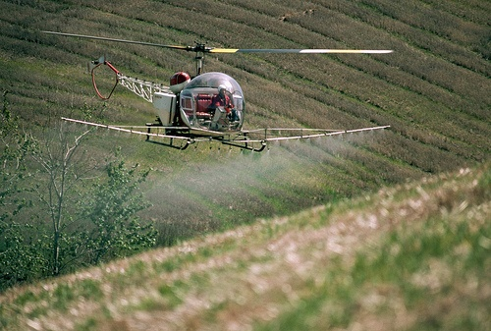
Herbicides
Chemicals used to manipulate or control undesirable vegetation.
Act by inhibiting cell division, photosynthesis, or amino acid production or by mimicking natural auxin hormones, which regulate plant growth, and causing deformities in new growth.
Methods of application include spraying onto foliage, applying to soils, and applying directly to aquatic systems.
http://www.steadyhealth.com/
http://www.uhcc.uh.edu/prairie/index.htm

Slide 6
Toxicology
The study of the (adverse) effects of chemicals on living organisms
Symptoms
Mechanisms
Treatments
Detection of poisoning
http://sciencegames.4you4free.com/poisons_toxicology.html

Slide 7
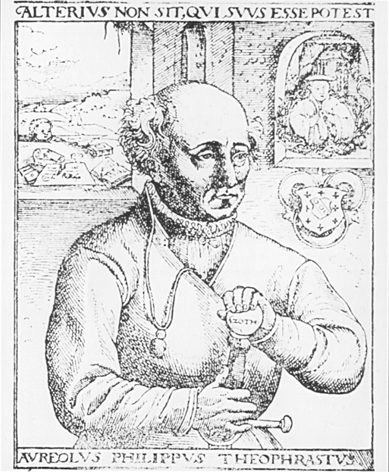
Presence ≠ Toxicity
Dose-response relationship
“All substances are poisons; there is none which is not a poison.
The right dose differentiates a poison from a remedy.”
-Paracelsus (1493-1541)

Slide 8
Determining Risk
Risk = Exposure X Toxicity
Exposure
Risk
Toxicity
Risk

Slide 9
Risk Assessment
The qualitative or quantitative estimation of the likelihood of adverse effects that may result from exposure to specified health hazards
Hazard ID
Exposure
Dose-Response
Risk Characterization
Risk Management
Risk Communication
Hazard Identification
Exposure Assessment
Toxicity Assessment
Risk Characterization
Risk Management

Slide 10
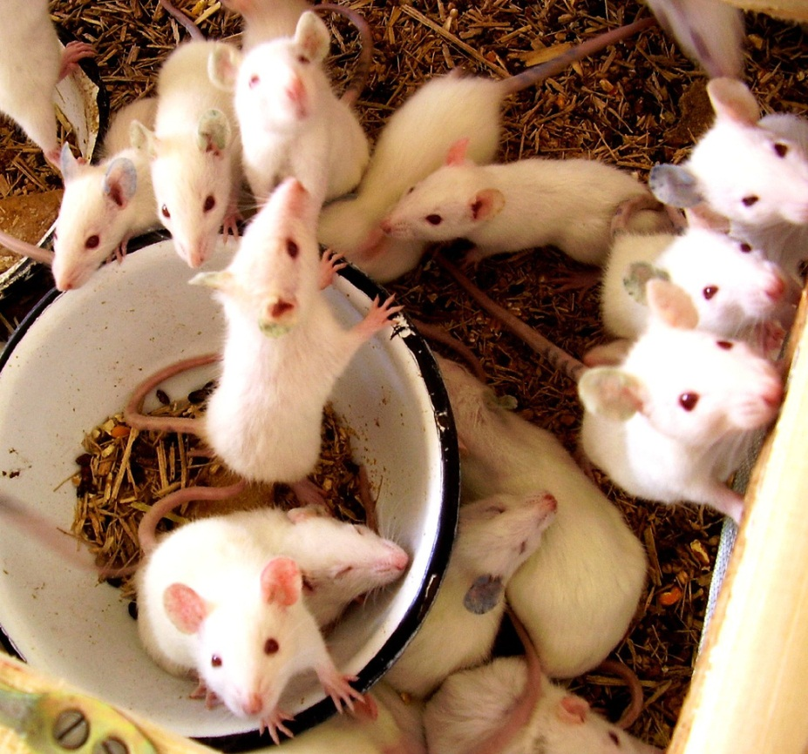
Hazard ID
Hazard is the inherent properties of a substance, object or activity with a potential for adverse, or harmful, effects to occur.
Data are from
in vitro
in vivo
epidemiology
clinical studies
Hazard Identification

Slide 11
Exposure Assessment
Describes the populations at risk
Adults
Children
Occupational
Identifies the exposure routes and pathways
Inhalation
Ingestion
Dermal
Exposure Assessment
Estimates the amount of chemical the public or workers might receive
Estimates average and maximum use rates

Slide 12
Exposure Assessment
Occupational Exposure to herbicides
Mixing
Loading
Manual spray
Aerial spray
Drift
Previous treatment
Exposure Assessment

Slide 13
Toxicity Assessment
What is most sensitive endpoint?
Cancer and noncancer toxicity values
Toxicity values
Reference Doses
sensitive subpopulations
daily exposure
Cancer potency factors
Toxicity Assessment

Slide 14
Risk Characterization
Quantifies the risk by comparing to the RfD and acceptable cancer risk rates
Occupational Exposure Levels
Individual and multiple pathways of exposure
Individual chemicals and chemicals commonly used together
Additive effects
Synergistic effects
Adjuvants, inerts, impurities
Risk Characterization

Slide 15
What is “Acceptable?”
Hazard Quotient | Cancer Risk | Potential Risk Category
≤1 | ≤1 in 100,000 | Negligible
>1, ≤10 | 1 in 100,000 to 10,000 | Low
>10, ≤100 | 1 in 10,000 to 4 in 1000 | Moderate
>100 | >4 in 1000 | High
The designations of “low,” “moderate,” and “high” risks should not be interpreted as describing the actual or likely health risks in a population. Instead, this designation characterizes a level of priority for risk management decisions.

Slide 16
Risk in perspective
Elevated risk does not mean that adverse effects will occur
Assumptions are conservative
Assumes daily exposure
Assumes most sensitive population
Excess risk of 1 in 100,000
1 in 3 people will develop cancer in a lifetime
1 in 100,000 is 0.00001
0.33333
+0.00001
0.33334

Slide 17
Risk Management
The opportunity to reduce risk
Prioritize use based on risk
Identify alternatives
Reduce exposure
Use protective equipment
Risk = Exposure X Toxicity
Risk Management

Slide 18
Example
What are the possible chemicals of concern?
2,4-D
Aminocyclopyralid (Perspective)
Aminopyralid (Milestone)
Bromacil (Hyvar)
Chlorsulfuron (Telar)
Diuron (Karmex)
Flumioxazin (Payload)
Glyphosate (Roundup)
Imazapyr (Arsenal)
Indaziflam (Esplanade)
Metsulfuron (Escort)
Picloram (Tordon)
Prodiamine
Pyroxasulfone (Piper)
Saflufenacil (Detail)
Sulfometuron (Oust)
Triclopyr (Garlon)
Chemical X

Slide 19
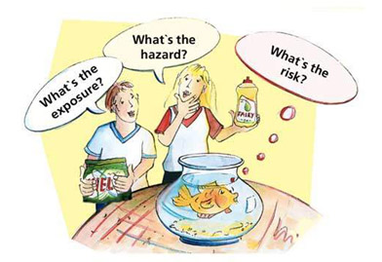
Example
What is the hazard?
Non-cancer
What is the exposure?
Measure or estimate exposure rate
Maximum and average
Population: Applicators and public who may eat or touch sprayed vegetation
Route: Inhalation and dermal
Calculate a dose: 100 μg/kg-d
http://www.scienceinthebox.com

Slide 20
What are the results
Toxicity
Dose-response, what is most sensitive adverse effect?
RfD is10 μg/kg-d
Characterization
HQ = Dose / RfD = 100 mg/kg-d / 10 μg/kg-d = 10
HQ > 10, risk is moderate
Management
Different herbicide
Lower application rate
Mechanical intervention
Risk = Exposure X Toxicity

Slide 21
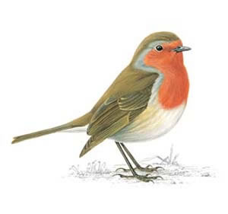
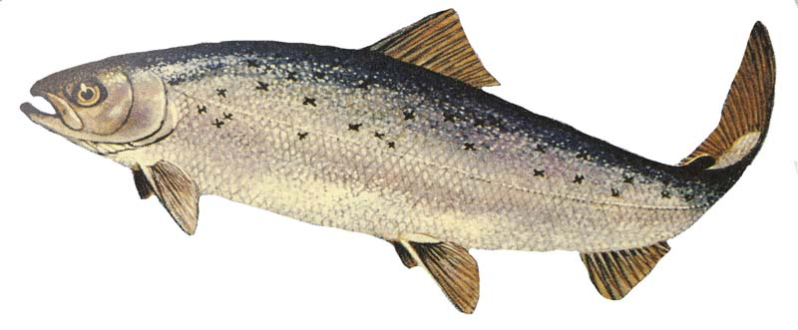
Ecotoxicology
http://www.classicinsulation.com/pest-control/fieldmouse.html
http://www.rspb.org.uk/wildlife/birdguide/name/r/robin/index.aspx
Rat
Quail
Deer mouse
Meadow vole
Marsh wren
Robin
Fish
Aquatic invertebrates
http://www.fda.gov/AdvisoryCommittees/CommitteesMeetingMaterials/VeterinaryMedicineAdvisoryCommittee/ucm222635.htm

Slide 22
What you can do
Always follow application instructions
Use personal protective gear when handling chemicals
Wash your hands
http://www.momsteam.com/
http://www.safetyworld.com

Slide 23
Questions?
Lisa Corey, PhD, DABT
lcorey@intertox.com
INTERTOX, Inc. SCIENCE STRATEGY RESEARCH
Source: http://www.lesliehawes.com/wordpress/wp-content/uploads/2007/10/raise-your-hand.jpg

